Slide 1
Natural Language Processing
Jacob Eisenstein
Direct Studies - Book Report
By Mahtab Tamannaee
Winter 2021

Slide 2
Introduction on this book...

Slide 3
This book...
Focus is on a core of the NLP, and the concepts of learning and search.
NLP problems can be solved by a set of learning and search methods.
How these methods work, and can be applied to NLP tasks.
NLP Task Examples:
Document classification, word sense disambiguation, part-of-speech tagging, named entity recognition, parsing, coreference resolution, relation extraction, discourse analysis, language modeling, and machine translation.

Slide 4
This book: NLP Task Examples
NLP Task Examples:
Document classification
Word sense disambiguation
Part-of-speech tagging
Named entity recognition
Parsing
Coreference resolution
Relation extraction
Discourse analysis
Language modeling
Machine translation.

Slide 5
This book : Search and Learning Methods
Search Methods : Viterbi, CKY, minimum spanning tree, shift-reduce, integer linear programming, beam search.
Learning Methods : Maximum-likelihood estimation, logistic regression, perceptron, expectation maximization, matrix factorization, backpropagation.

Slide 6
The Organization of this book...

Slide 7
This book : Organization
This textbook is organized into four main units:
Learning
Sequences and trees.
Meaning
Applications

Slide 8
This book : 1. Learning Unit
This section builds up a set of machine learning tools that will be used in the other sections.
Because the focus is on machine learning tools, the text representations and linguistic phenomena are mostly simple: “bag-of-words” text classification is treated as a model example.
Chapter 4 describes some of the more linguistically interesting applications of word-based text analysis.

Slide 9
This book : 2. Sequences and trees Unit
This section introduces the treatment of language as a structured phenomena.
It describes sequence and tree representations and the algorithms that they facilitate, as well as the limitations that these representations impose.
Chapter 9 introduces finite state automata and briefly overviews a context-free account of English syntax.

Slide 10
This book : 3. Meaning Unit
This section takes a broad view of efforts to represent and compute meaning from text, ranging from formal logic to neural word embeddings.
It also includes two topics that are closely related to semantics: resolution of ambiguous references, and analysis of multi-sentence structure.

Slide 11
This book : 4. Applications Unit
The most prominent applications of NLP will be discussed in last chapters:
1. Information Extraction
2. Machine Translation
3. Text Generation

Slide 12
The Chapters in this book...

Slide 13
This book:
Base NLP Chapters
The review of probability in Appendix A
Chapters 1-3 provide building blocks that will be used throughout the book
Chapter 4 describes some critical aspects of the practice of language technology.
Language models (chapter 6), sequence labeling (chapter 7), and parsing (chapter 10 and 11) are canonical topics in NLP distributed word embeddings (chapter 14)
Of the applications, machine translation (chapter 18) is the best choice: it is more cohesive than information extraction, and more mature than text generation.

Slide 14
This book:
Machine Learning Chapters
The chapter on unsupervised learning (chapter 5).
The chapters on predicate-argument semantics (chapter 13), reference resolution (chapter 15), and text generation (chapter 19) are particularly influenced by recent progress in machine learning, including deep neural networks and learning to search.

Slide 15
This book:
Linguistic Orientation Chapters
The chapters on applications of sequence labeling (chapter 8), formal language theory (chapter 9), semantics (chapter 12 and 13), and discourse (chapter 16).

Slide 16
This book:
Application Chapters
The chapters on applications of sequence labeling (chapter 8), predicate-argument semantics (chapter 13), information extraction (chapter 17), and text generation (chapter 19).

Slide 17
The Notations used in this book...

Slide 18
As a general rule...
Words, word counts, and other types of observations are indicated with Roman letters (a, b, c).
Parameters are indicated with Greek letters (α, β, θ).
Vectors are indicated with bold script for both random variables x and parameters θ.

Slide 19
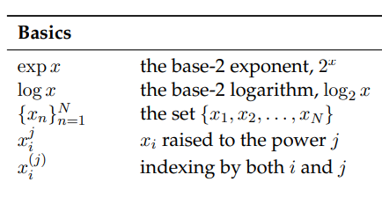
Basic Notations :

Slide 20
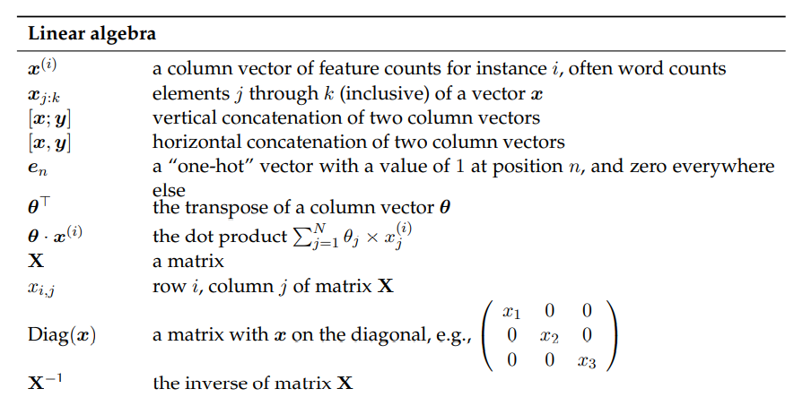
Linear Algebra Notations :

Slide 21
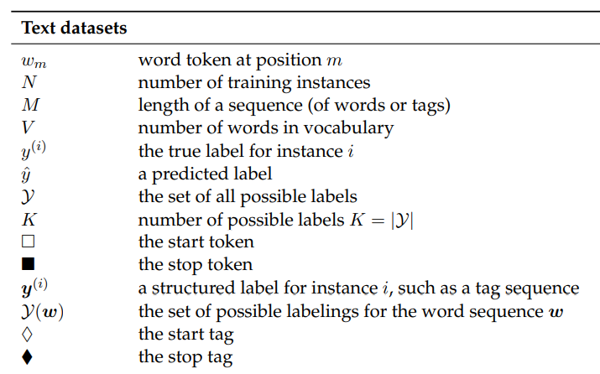
Text Dataset Notations :

Slide 22
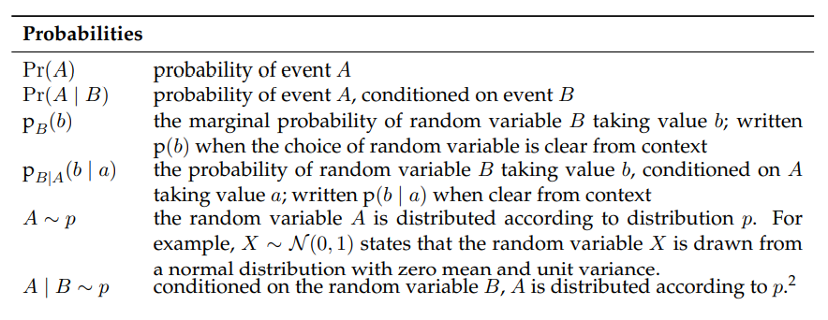
Probability Notations :

Slide 23
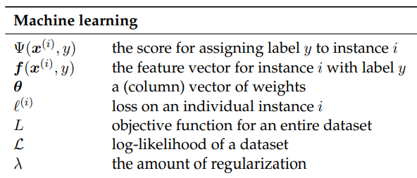
Machine Learning Notations :

